Slide 1
Blood gases in toxicology
Jonathan Brett

Slide 2

Anion Gap
Delta Gap
Osmolar Gap
Lactate Gap
History Gap
Knowledge Gap

Slide 3
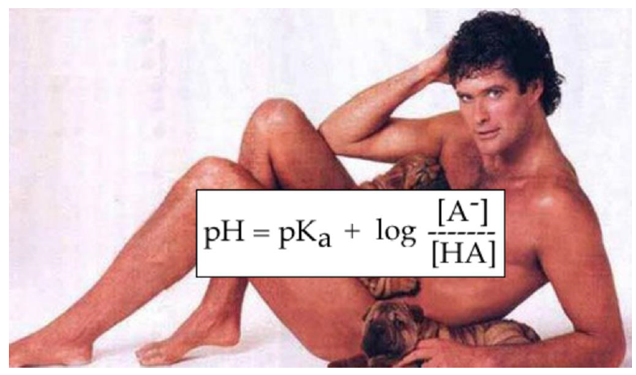

Slide 4
Anion Gap
Anion gap = Na+ -(Cl-+ HCO3-)

Slide 5
High Anion Gap Metabolic Acidosis
    Carbon monoxide, Cyanide
    AKA, Alcohol
    Toluene
    Methanol, Metformin
    Uraemia
    DKA
    PGA/Paracetamol/Propylene glycol/Propofol
    INH, Iron
    Lactic acidosis
    Ethylene glycol
    Salicylates, Strychnine

Slide 6
High Anion Gap Metabolic Acidosis
Lactate
Ketones
Renal Failure
Toxins

Slide 7
Case 1
43M Microbiology Scientist
Excessive alcohol use
Found unconscious (GCS 6) on floor
Vomiting
Empty bottle of clear liquid next to him with no labels

Slide 8
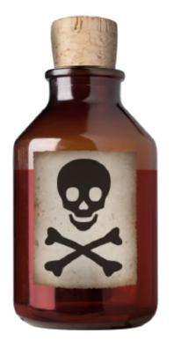

Slide 9
Case 1
pH 7.26
pCO2 49
HCO3 21
Lactate 3.6
BE -5.6
Ethanol 64 mmol/L
Metabolic Acidosis & Respiratory Acidosis (mild)

Slide 10
Case 1
Calculated Osmolarity285
Measured Osmolality 365
=
OG 80

Slide 11
Osmolar Gap
Methanol
Ethylene Glycol
Dyes (contrast)
Isopropyl alcohol
Ethanol
O(other)
Notes:
Mannitol, sorbitol, polyethylene glygol, glycine

Slide 12
Calculated osmolarity
Calculated Osmolarity = 2Na + gluc+ urea + 1.25(ethanol)
Units must be mmol/L
mg/dl (÷ 4.6)
% (× 218)

Slide 13
Case 1
Calculated Osmolarity285
Measured Osmolality 365
=
OG 80
Ethanol 64 (x 1.25) = 80
OG = 0

Slide 14
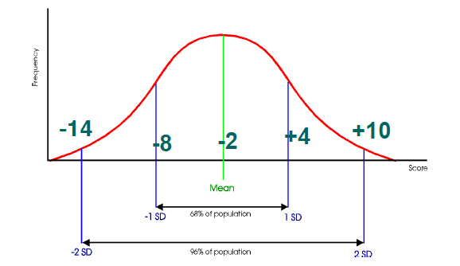
Normal osmolar gap

Slide 15
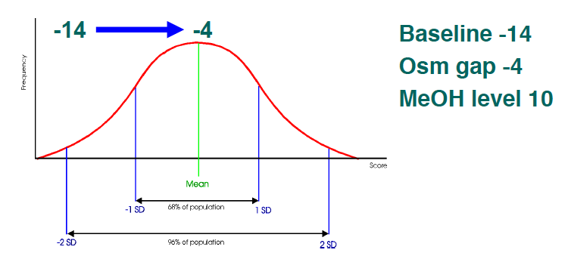
Osmolar gap

Slide 16
Case 2
08:30–well
12:30 -drowsy and confused
GCS 12 HR112 BP 159/103
pH 7.19 CO226 BE -16
BSL 9 Lactate 35 Cr 61
Other bloods pending

Slide 17
Case 2
Progress:
Paracetamol undetected
Ethanol undetected
Osmolar gap 40
Intubated
Ethanol Infusion
and
Dialysis commenced (CVVHDF)
Next day:
pH 7.35 BE -10, Lactate 5.2
Methanol and ethylene glycol concentrations negative

Slide 18
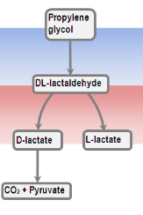
Propylene glycol
‘Environmentally safe’ antifreeze
Diluent for pharmaceuticals
Extremely high lactate concentrations as a metabolite (d-lactate)

Slide 19
Case 3
26M
Methamphetamine user
Drug-induced psychosis
Personality disorder
Went to police claiming he was stabbed Agitated with auditory hallucinations
Brought to ED 1h ago.
Claiming he had home brew -no other details.

Slide 20
Case 3
Agitated
Sweaty
Psychotic
HR 140
Normotensive
RR 30
Afebrile

Slide 21
Case 3
pH 6.9
CO2 28
HCO3 6
Na 135
Cl 105
lactate 26
BE -24
Na 139
Cl 96
Ur 4.3
Cr 199
glucose 21.5
Ethanol –undetected
Serum osmolality 319

Slide 22
Case 3
What kind of acidosis is this?
HAGMA
NAGMA
Resp. acidosis
I’m not willing to commit at this stage

Slide 23
Case 3
Anion gap
=Anion gap = Na+ -(Cl-+ HCO3-)
= 135 – (105+6) = 24
HAGMA
(lactic acidosis)

Slide 24
Case 3
Delta Ratio = the increase in Anion Gap / the decrease in HCO3-
= [actual anion gap – “normal AG]/”normal” – actual bicarb]
= (24-12)/(24 – 6) = 0.66
NAGMA (renal failure)
< 0.4: Hyperchloraemic NAGMA
0.4-0.8: Mixed NAGMA + HAGMA
1-2: HAGMA
>2: HAGMA on background of chronic metabolic alkalosis (e.g. COPD with type 2 resp failure)

Slide 25
Case 3
Expected PaC02 (Winters formula)
= (HCO3 x 1.5) +8 (±2)
= (6 x 1.5) +8 = 17 (actual 28)
(respiratory acidosis)

Slide 26
Case 3
Given IM droperidol with good effect.
HR 120 RR 22 GCS 14 and calmer
2.5L IV Fluids

Slide 27
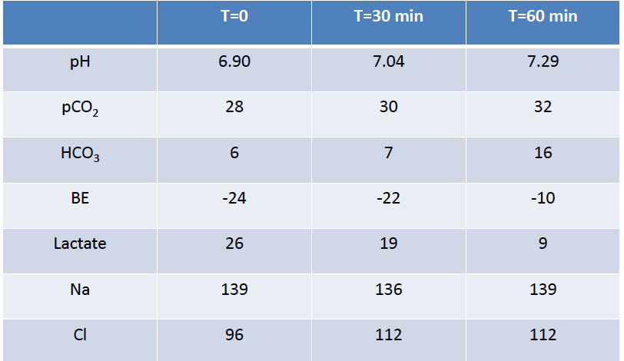
Case 3

Slide 28
Case 4
52 F
Well at 0930 but husband found at 1130 drowsy on floor
Initial Obs:
HR 134, BP 142/87, Sp02 96% on 10L NRB
GCS 13 (E3, V4, M6)

Slide 29
Case 4
  RR 30, BP 150/102, HR 106, Sats 100% on 2LNP
  pH 7.19, CO 26, HCO3 20, Lactate 25, BSL 7.5
  Na 145, Cl 111, Ur 3.9, creat 66, BSL 5.1, BAC 10, measured osmo 357
  Calculate the gaps…
  AG = 14 (but lactate 25)
  OG = 46

Slide 30
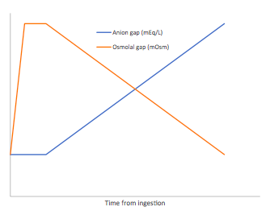
Ethylene glycol

Slide 31
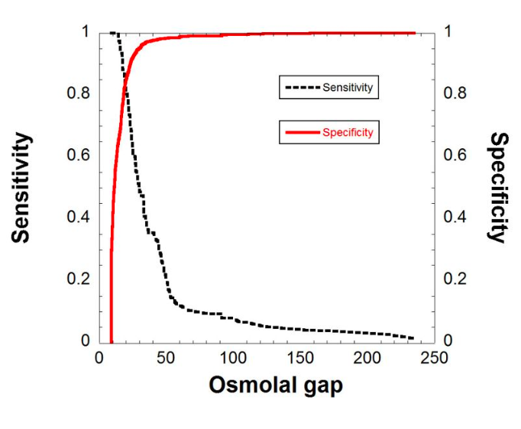
Krasowski et al. BMC Clinical Pathology 2012, 12:1

Slide 32
Lactate gap
Increases in lactate usually an indicator of anaerobic metabolism (exep. Propylene glycol)
Lactate gap = lactate (measured by oxidase method) – laboratory lactate (dehydrogenase method)
Caused by EG cross reacting
Esp. point of care analysers (e.g. Radiometer 700 >> iSTAT and Bayer)

Slide 33
Case 5
59 female
Seen by son at 3pm previous day and drowsy
Son thought she may be post-ictal so observed her at home
Became concerned when no improvement and called ambulance 8 hours later
A- patent
B - RR 8, Sa02 100% on 15L NRB chest clear
C - Warm, well perfused, HR 120, BP 133/110 HSDNM
D - GCS 10 - E 3, V2, M 5
- pupils equal 3mm, sluggish
- normal tone and reflexes
E - Temp 36.4
- no obvious injuries or abnormalities

Slide 34
Case 5
BKG.
  Chronic low back pain
  Hypertension
  Epilepsy - last seizure 18 months ago
  Previous gastric surgery for perf. DU in 2012
  Denies ETOH or illicit drug misuse
  Increasing abdominal pain, anorexia and 15Kg since Christmas.

Slide 35
Medications
Oxycontin 80mg BD
Pantoprazole: 80 mg, Oral, Twice daily
Nizatidine: 300 mg, Oral, Nocte.
Amlodipine: 10 mg, Oral, Mane
Valsartan: 320 mg, Oral, Once daily
Paracetamol: 1 Grams, Oral, Four times daily
Domperidone 10 mg: Oral, Three times daily
Metoprolol: Unchanged, 100 Milligrams, Oral, Twice daily
Prazosin: Unchanged, 5 Milligrams, Oral, Twice daily
Phenytoin: Unchanged, 200 Milligrams, Oral, Twice daily
Gabapentin: Unchanged, 800 Milligrams, Oral, Twice daily

Slide 36
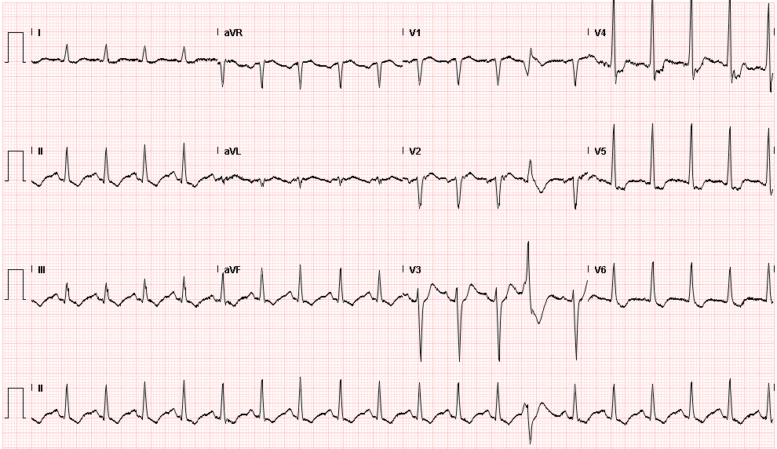
Initial ECG

Slide 37
Initial bloods
Results | 9/02/2014
pH | 7.07
p02 (mmHg) | 233
pc02 (mmHg) | 27
Sp02 | 99%
Bicarb (mmol/L) | 10
BE (mmol/L) | -18
gluc (mmol/L) | 5.9
Lactate (mmol/L) | 0.5
Na+ (mmol/L) | 135
K+ (mmol/L) | 2.7
Cl- (mmol/L) | 112
Bicarb | 10
Ur (mmol/L) | 7
Cr (mmol/L) | 88
Albumin | 37
ALP | 154
GGT | 235
ALT/AST | N
Trop HS | 17
Calc/Mg/Pos | N
Lipase | 932
WCC | 26.2
Neut | 24.1
Hb | 131
PLT | 661
Osmo | 297
INR | 1.1
Salicylate | Neg
TSH | N
UDS | Opioids

Slide 38
Case 5
Anion gap
= 135 – (10+112) = 13 [NAGMA]

Slide 39
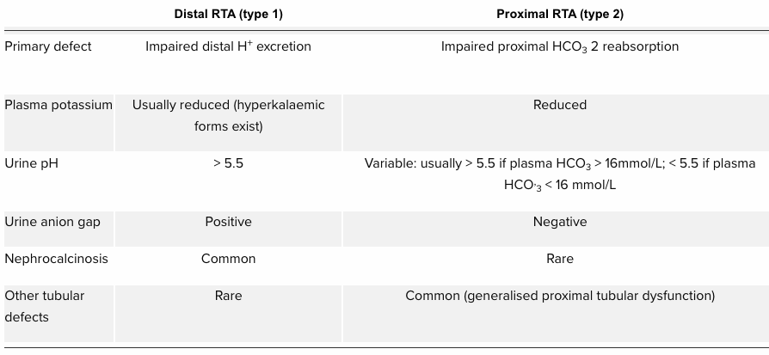
Case 5
NSAID abuse (neurofen plus)
[Na]+[K]-[Cl]
Notes:
Urine AG to differentiate GI and renal causes NAGMA
– if GI losses then kidneys can compensate by loosing ammonia (and CL) meaning increased gap
-If renal then kidneys can’t compensate and gap negative at CL retained

Slide 40
NAGMA
Bicarbonate loss or chloride retention
Drugs
  Acetazolamide and other CA inhibitors (e.g. topiramate)
  Cholestyramine
GI losses
Excess NaCl 0.9%
Renal losses –RTA
Addisons
Hyperchloraemia
Acetazolamide, Addison’s
Renal tubular acidosis
Diarrhoea, ileostomies, fistulae
Ureteroenterostomies
Pancreatoenterostomies

Slide 41
Acidosis (pH<7.35)
⬇Bic, normal/low C02
⬆C02, normal bic - respiratory
⬆AG - HAGMA
Delta Ratio ?NAGMA component
⬆OG (adjusted for ETOH) ?toxic alcohol
?adequate respiratory compensation

