Slide 1
ED, Rehab & TBI
Dr Simon Mosalski: Rehabilitation staff specialist
MS Ellie Thorne – Neurosurgical Occupational Therapist
june 2018

Slide 2
Why this Topic?
In NSW over 100,000 people currently have a brain injury
1000 people a year sustain a tbi and have long-term disability as a result
Emerging evidence that frequent mild head trauma leads to long term sequalae
Increasing articles in the medical literature and increased interest in the lay press
The Eastern Suburbs: The home of the high profile‘coward punch’, but don’t forget the the affluent 15 year old saturday morning rugby player ……
Whatever the mechanism, are we doing enough to protect this cohort who receive seemingly innocuous injuries?

Slide 3
Todays talk
Rehabilitation Medicine and the SVH Service
What is a TBI?
Mild, moderate and severe brain injury
Post-concussive syndrome
What is the role of Rehabilitation Medicine in caring for these patients?
How can we work together to improve care for these patients?

Slide 4
What is rehab medicine and what do we do?
Rehabilitation Medicine is the diagnosis, assessment and management of an individual with a disability due to illness or injury
A rehabilitation team works with people with a disability to help them maximise their level of performance and improve their quality of life
We practise a multi-disciplinary and holistic approach in both in and out-patient care settings
Acquired brain injury
SCI
Developmental delay
Stroke
Orthopaedics
Amputees
Spina bifida
Transitional care
Oncology and palliative rehab
Pain medicine
Complex discharge planning
Medical and surgical deconditioning…

Slide 5
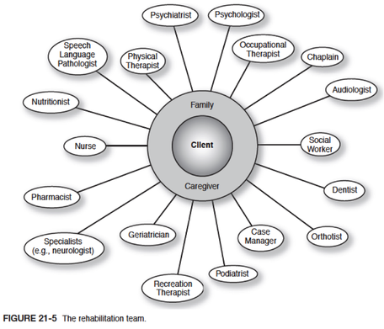
The Rehab model of care
6 Care Settings
Inreach to acute (MRT)
Sub-Acute inpatient
Ambulatory Care: Day Hospital
Ambulatory Care: Outpatients
Ambulatory Care: Home Based (TACP or community Physio)
Outreach

Slide 6
Rehab at st vincents
7 Staff Specialists – 4 with an in-pt caseload
  Dr Faux: Director and Neuro/Neurosurgical
  Dr Wu: Transplant medicine, HIV and Oncology: MRT
  Dr Brooke: Geriatric Rehabilitation
  Dr Arundalanam: Day Hospital
  Dr Watanabe: Spasticity Management
  Dr Sun: Day Hospital and Chronic Pain
  Dr Mosalski: Ortho, Prosthetics & Trauma: Griffith base hospital
1 Fellow, 2 Registrars 2 RMOs & a CNC
Visiting Monthly Brain Injury Specialist: Dr Stuart Brown from Royal Ryde
Allied Health Team
Clinical Research Department: virtual reality, robotics, hyperacute models of care
32 in patient beds on Level 2 in the Sacred Heart Building
Physio Gym
OT Gym
Dedicated Speech therapy room
Treatment room for botulinum toxin injections and other procedures
OT Kitchen
Dining & therapy room
Day hospital with clinic rooms
Garden and outdoor therapy area
Psychology/counselling room

Slide 7
what is a brain injury?
What is a Traumatic Brain Injury? (USA Dept of Defense)
What is an Acquired Brain Injury? (Brain Injury Survivors Network)
A traumatically induced structural injury and/or physiological disruption of brain function as a result of an external force that is indicated by new onset or worsening of at least one of the following clinical signs, immediately following the event:
  Any period of loss of or a decreased level of consciousness;
  Any loss of memory for events immediately before
  or after the injury;
  Any alternation in mental state at the time of the
  injury (confusion, disorientation, slowed thinking, etc.)
  Neurological deficits (weakness, loss of balance,
  change in vision, praxis, paresis/plegia, sensory loss,
  aphasia, etc.) that may or may not be transient
An acquired brain injury is an injury to the brain that has occurred after birth, but is not related to congenital defect or degenerative disease.
Causes of ABI include (but are not limited to) hypoxia, illness, infection, stroke, substance abuse, toxic exposure, trauma, and tumor. ABI may cause temporary or permanent impairment in such areas as cognitive, emotional, metabolic, motor, perceptual motor and/or sensory brain function

Slide 8
Primary injury (focal or diffuse)
Direct disruption of the brain parenchyma from the shear forces of the impact. It occurs immediately (minutes to hours after the impact) and is not amenable to medical intervention.
Contusions:
  bruising of the cortical tissue
Diffuse axonal injury (DAI):
  immediate disruption of the axons due to acceleration–deceleration and rotational forces that cause shearing upon impact. There is also evidence of a secondary axotomy due to increased axon permeability and calcium influx and cytoskeletal abnormalities that propagate after the injury. Clinically, the coupling of the injury to these structures leads to the picture of white matter petechial hemorrhages characteristic of DAI → ?post-concussive syndrome
Impact depolarization:
  massive surge in extracellular potassium and glutamate release (excitatory) occurs after severe head injury and leads to excitotoxicity (secondary injury) → ?post-concussive syndrome

Slide 9
Secondary injury (focal or diffuse)
Cascade of biochemical, cellular, and molecular events, which include both endogenous cerebral damage as well as extra- cerebral damage that come with trauma, mechanisms include :
Ischemia, excitotoxicity, energy failure which result in apoptosis
Secondary cerebral swelling
  Brain Swelling: occurs early on after acute head injury within 24 hours. Due to an increase in cerebral blood volume (intravascular blood) and identified in CT as collapse of ventricular system and loss of CSF cisterns around the midbrain.
  Brain Oedema: occurs later after head injury. Due to an increase in brain volume secondary to increased brain water content leading to extravascular fluid. There are two types of brain oedema:
1. Vasogenic oedema: Due to outpouring of protein rich fluid through damaged vessels. Extracellular oedema due to cerebral contusion
2. Cytogenic oedema: Found in relation to hypoxic and ischemic brain damage. Due to failing of the cells’ energy supply system leading to an increase in the cell-wall pumping system causing intracellular oedema in the dying cells.
Axonal injury
Inflammation and regeneration

Slide 10
Assessing a brain injury in ed

Slide 11
Who gets a Scan?
Canadian CT Head Injury Trauma Rules
New Orleans Criteria
GCS <15 at 2 hours post-injury
Suspected open or depressed skull fracture
Any sign of basilar skull fracture?
Hemotympanum, raccoon eyes, Battle’s Sign, CSF oto-/rhinorrhea
≥ 2 episodes of vomiting
Age ≥ 65
Retrograde amnesia to the event ≥ 30 minutes
“Dangerous” mechanism?
  Pedestrian struck by motor vehicle, occupant ejected from motor vehicle, or fall from > 3 feet or > 5 stairs.
Headache
Vomiting
Older than 60 years
Drug and alcohol intoxication
Persistent anterograde amnesia (deficits in short-term memory)
Visible trauma above the clavicle
Seizure

Slide 12
Assessing a brain INjury
Glasgow Coma Scale
GOAT: Galverstan Orientation and Amnesia Test
Glasgow Outcome Scale
Disability Rating Scale
Westmead PTA
A-WPTAS
Rancho Los Amigos Levels of Cognitive Function Scale
FIM: Functional Independent Measures
JFK Coma Recovery Scale

Slide 13
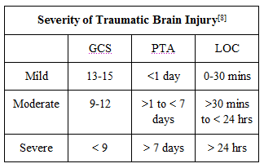
Assessing a brain INjury
Notes:
The most widely used definition of MHI or mild TBI is that which results in a period of loss of consciosness lasting less than 30 mins and an initial GCS of 13-15, and a period of PTA less than 24 hours. These injuries constitute approximately 80% of all head injuries (and a lot of these will not be hospital admissions). We use the AWPTAS to assess mild head injures , and Pta for moderate to severe.

Slide 14
A-wptas: GCS (15 points) and Picture cards (3 points)
The A-WPTAS combined with a standardised GCS assessment is an objective measure of post traumatic amnesia (PTA) in those with a mTBI.
Only for patients with current GCS of 13-15 (<24hrs post injury) with impact to the head resulting in confusion, disorientation, anterograde or retrograde amnesia, or brief LOC. Administer both tests at hourly intervals to gauge patient’s capacity for full orientation and ability to retain new information. Also, note the following: poor motivation, depression, pre-morbid intellectual handicap or possible medication, drug or alcohol effects.
NB: This is a screening device, so exercise clinical judgement. In cases where doubt exists, more thorough assessment may be necessary.
Admission and Discharge Criteria:
  A patient is considered to be out of PTA when they score 18/18.
  Both the GCS and A-WPTAS should be used in conjunction with clinical judgement.
  Patients scoring 18/18 can be considered for discharge.
  For patients who do not obtain 18/18 re-assess after a further hour.
  Patients with persistent score <18/18 at 4 hours post time of injury should be considered for admission.
  Clinical judgement and consideration of pre-existing conditions should be used where the memory component of A-WPTAS is abnormal but the GCS is normal (15/15).
  Referral to GP on discharge if abnormal PTA was present, provide patient advice sheet.
Notes:
At St Vincent’s we used both AWPATs and PTA as a standardiesed assessment of the level of head injury
Does anyone know what an abbreviated Westmead post traumatic amnesia scale is?
-standardised assessment tool assess wether the patient is still in post traumatic amnesia following a head injury.
If not passing possibly sustained a mild-mod head injury.
Recent retrospective study by Watson et al. 2017 conducted at Liverpool hospital found that when AWPTAs is conducted in ED- over that two year period 91% of patients were assessed using AWPTAs (of that 94% cleared within the 4 hours)-56% has a shorter length of stay and 295 bed days saved.
Question: If a drunk person comes in with a head injury should I conduct AWPTAs?
Is there GCS 14-15, do you need wait 20 hours until the patient is sober and conduct this. How would you manage this? –hand over to the nurse looking after the patient the specific time that AWPATAs it to be conducted.
When assessing these patients (within 24 hours post injury), we want to be aware of any drug/ alcohol influence? Age-dementia? Psychiatric background/ hpoxic brain injury.
Clinical judegment is important and there have been numerous cases where we have seen patients admitted to the ward who have passed AWPTAS who have well below functional baseline and required further rehab. Aware that even mild TBI can cause significant morbidity, with cognitive defecitis. Including reduced memory for new information, slower information processing, and behavioural changes. If there are any concerns with pts function you can always refer onto OT after admitted to the ward.

Slide 15
Westmead post traumatic assessment scale
Based on the work of the Oxford group.
It consists of 7 orientation questions and 5 memory items designed to objectively measure the period of post-traumatic amnesia (PTA).
The Westmead PTA Scale is a standardised and prospective measure of PTA and represents a move away from the subjective and retrospective estimates of the past.
A key feature is that it uses an operational definition of PTA. That is, a person is said to be out of PTA if they can achieve a perfect score for 3 consecutive days. PTA is judged to have ended on the first of the 3 consecutive days of perfect recall.
Why three days? The patient's first memory of his surroundings may be followed by a further period of clouded consciousness and amnesia. This is an 'island of memory’ and may be followed by further amnesia for a day or two; it is therefore the beginning of continuous memory which is to be used as part of the assessment.
Notes:
Difference between the AWPATs and the PTA is that these is conducted over a minimum of four days (if they pass daily).
This means that it is very important to conduct AWPTAs if appropriate in ED otherwise will automatically mean a 4 day LOS in acute care
Selection criertia: psychiatric disorders, background dementia, drug and alcohol history

Slide 16
Testing
Requires a pen; the Westmead PTA Scale MR-120 Form; and the set of 9 picture cards.
Testing should ideally take place at the bedside in a quiet ward room.
There should also be no obvious cues or aids like clocks or orientation boards nearby.
For patients with a history of psychiatric illness, developmental or intellectual disability, substance abuse, previous head trauma, or nervous system disease the usefulness of the scale remains undetermined. It isn’t validated in hypoxic brain injury.
PTA testing begins when the patient has regained consciousness and can communicate intelligibly – This INCLUDES in ICU!
Notes:
*McLellan et al. 2017 published an article on the effects of opiods and PTA testing and found that caution should be applied assessing when assessing the patient with the PTA scale as it can effect their ability to retain new information (anterograde memory)
-ability to retain new information

Slide 17
The questions:
Question 1: HOW OLD ARE YOU ?
Question 2: WHAT IS YOUR DATE OF BIRTH ?
Question 3: WHAT MONTH ARE WE IN ?
Question 4: WHAT TIME OF DAY IS IT ? (MORNING, AFTERNOON OR NIGHT)
Question 5: WHAT DAY OF THE WEEK IS IT ?
Question 6: WHAT YEAR ARE WE IN ?
Question 7: WHAT IS THE NAME OF THIS PLACE ?
Question 8: HAVE YOU SEEN MY FACE BEFORE ? All this question requires is a simple yes / no answer.
Question 9: WHAT IS MY NAME ? If the patient fails to respond spontaneously a choice of 3 names is given. They should start with the same letter and have the same number of vowels. For example: 'Lisa, Linda or Lesley'.
Question 10: WHAT WERE THE 3 PICTURES THAT I SHOWED YOU YESTERDAY ? If the patient can not spontaneously recall the picture cards, there are 2 acceptable presentation modes: (1) Showing all 9 cards to the patient, one at a time; or (2) Laying all 9 cards out on a table. In both cases the patient must pick the 3 target cards either by saying 'yes' / 'no' or by pointing.

Slide 18
Summarising
At the end of testing you need to rehearse with the patient.
That is, before leaving the patient you must correct their mistakes, tell them what they have to remember for tomorrow and check whether they have encoded it properly.
Go through the incorrect items with the patient e.g. 'John you got a couple of items wrong: today is Monday; and it is morning.’
Remind the patient what they have to remember for tomorrow. (This is also the time to introduce the patient to the new picture cards if they have scored 12 out of 12.) Show the 3 picture cards and go through them with the patient. Then say, 'John I will be coming to see you tomorrow and I want you to remember my name - Lesley - and the 3 pictures I have shown you - Bird, Flower and Cup.’
Check whether the patient has encoded the memory items properly. To do this you need to distract the patient for 1 to 2 minutes with some idle conversation e.g. 'What is your favourite TV show ?’ or 'What did you have for breakfast, lunch or dinner?'. Then ask the patient what they have to remember for tomorrow. Tell the patient whether they were right or wrong and correct any mistakes. Then prior to leaving, show the patient the 3 picture cards again and say, 'John, I want you to remember my name - Lesley - and the 3 pictures I have shown you - Bird, Flower and Cup.'

Slide 19
What does it matter: Mild vs moderate vs severe?
Length of PTA Likely Outcome
<1 day Expect quick and full recovery with appropriate management (a few may show persisting disability).
>1 day Recovery period more prolonged—now a matter of weeks or months.
<1 week Full recovery possible, for most of these cases, with good management.
1–2 weeks Recovery a matter of many months. Many patients are left with residual problems even after the recovery process has ended, but one can be reasonably optimistic about functional recovery with good management.
2–4 weeks Process of recovery is very prolonged—1 year or longer is not unusual. Permanent deficits are likely. There must be increasing pessimism about functional recovery when PTA reaches these lengths.
> 4 weeks Permanent deficits and significant disability likely. It is not just a matter of recovery, but of long- term retraining and management.

Slide 20
PTA and functional outcome
80% of patients with PTA <2/52 have a good outcome but only 46% of with PTA between 4-6/52
PTA of >48days indicative of poor employment outcome at 1 year post injury
PTA of >=54 days indicative of need for supervision in ADLS post injury
Notes:
DRIVING
Head Injury
A head injury will only affect driver licensing if it results in chronic impairment or seizures. However, any person who has had a traumatic
injury causing loss of consciousness should not drive for a minimum of 24 hours, and the effects on functions listed above should be
monitored. This is advisory and not a licensing matter.
Minor head injuries involving a loss of consciousness of less than one minute with no complications do not usually result in any long-term
impairment. Similarly, immediate seizures that occur within 24 hours of a head injury are not considered to be epilepsy but part of the
acute process, (refer to Acute symptomatic seizures, page 86).
More significant head injuries may impair any of the neurological functions listed in the checklist above and can impair long-term driving
ability. There may be focal neurological injury affecting motor or sensory tracts as well as the cranial nerves. Also personality or behavioural
changes may affect judgement and tolerance and be associated with a psychiatric disorder such as depression or post-traumatic stress
disorder (PTSD). Clinical, neuropsychological or practical driver assessments may be helpful in determining fitness to drive (refer to Part A
section 2.3.1 Practical driver assessments). Comorbidities such as drug or alcohol misuse and musculoskeletal injuries may also need to
be considered (refer to section 9 Substance misuse and section 5 Musculoskeletal conditions).98
Part B: 6
Neurological conditions
Assessing Fitness to Drive 2016
Neurological recovery from a traumatic brain injury may occur over a long period, and some people who are initially unfit may recover
sufficiently over many months such that driving can eventually be resumed.
Risk of post-traumatic epilepsy (PTE): Persons with depressed skull fractures, traumatic intracranial haematoma or severe traumatic
brain injury are at increased risk of epilepsy, especially in the first year. Commercial drivers therefore should not drive for 12 months after
the injury and require a conditional licence. Private driving may continue, provided the person otherwise meets the standard to drive (refer
to table – Head Injury). If one or more seizures have occurred, the symptomatic seizures standard applies. PTE should be distinguished
from immediate post-traumatic (acute symptomatic) seizures occurring within 24 hours of a head injury, which are considered part of the
acute process (refer to Acute symptomatic seizures, page 86).
Return to work
-particulalry discharges from ED what level of function / does the patient have to operate heavy machinery
-the level of opiods prescribed / return to driving?

Slide 21
The practicalities of Severe tbi management
from a rehab physicians point of view

Slide 22
What do I want to know about a patient with a severe TBI ..
History: mechanism of injury, neurosx management
  WHERE did the trauma occur? Workplace, Public or private road and appropriate paperwork completed
Seizures and anti-epileptics: why and when were they commenced – accurate seizure history
Delirium: ICU, TBI, Meds, Seizures.. So many reasons, manage as you would a delirious elderly patient
Behavioural management: AVOID all physical and chemical restraints unless patient is a danger to themselves or another:
  ASK REHAB NOT PSYCHIATRY! NeuroSx plan: follow-up imaging, whens the skull going back in and planned return to theatre
Polytrauma: Weight bearing restrictions
Family & carer support: SW referral
NDIS application

Slide 23
Treating Agitation in TBI: FIND the problem
GOOD
BAD
Anti-psychotics: Blocking D2 receptors can lead to positive or negative symptoms – Case by Case
Beta Blockers: Propanolol IV
Risperidone:
Mood Stabliser anti-epileptics
Lithium
Amantadine
Anti-psychotics: Blocking D2 receptors can lead to positive or negative symptoms - Case by Case
Benzos: Slows motor recovery and PTA resolution
Haloperidol: slows motor recovery

Slide 24
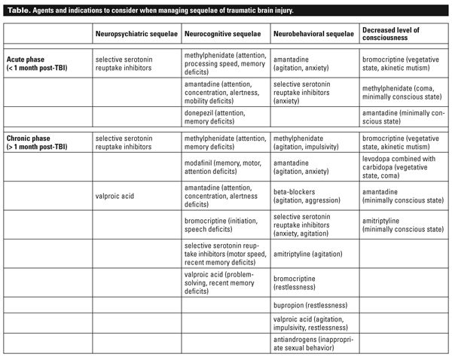

Slide 25
Disposition: Severe TBI in nsw
3 Statewide Brain Injury Units: Royal Ryde, Westmead and Liverpool (CTP funded)
  11 other services inc community, rural inpatient & transitional services
Admission Criteria:
  Working age
  With a discharge destination
  1 x Non-traumatic Brain Injury Unit and that’s in Victoria
Raises the question of long-term care for young patients with severe behavioural and functional disabilities …
We will often take a medically stable, containable BI patient to Sacred Heart whilst awaiting specialised BIU. However SHH is NOT a secure facility so absconding is a real risk in a cognitively impaired cohort

Slide 26
A quick slide on seizures +/- epilepsy
Immediate PTS: within the first 24 hours postinjury.
Early PTS: within the first week (24 hours to 7 days).
Late PTS: after the first week.
Risk Factors Associated With Late Posttraumatic Seizures
  Penetrating head injury: 33–50%
  Intracranial hematoma: 25–30%
  Early posttraumatic seizure (> 24 hours to 7 days): 25%
  Depressed skull fracture: 3–70%
  Prolonged coma or posttraumatic amnesia (> 24 hours): 35%
  Other risk factors: Dural tearing, Presence of foreign bodies, Focal signs such as aphasia and hemiplegia, Age, Alcohol abuse, Use of tricyclic antidepressants TCAs
TBI Severity and Incidence of Posttraumatic Seizures
A 1998 study evaluated a group of 4,541 patients with TBI (characterized by loss of consciousness, posttraumatic amnesia, SDH, or skull fracture) were divided into 3 categories:
• Incidence of seizures in these different categories:
– Mild TBI: 1.5%
– Moderate TBI: 2.9%
– Severe TBI: 17%
– Overall incidence (all patients): 3.1%
(Annegers et al, 1998.)

Slide 27
The practicalities of Moderate tbi management
From a rehab physicians point of view

Slide 28
MANAGEMENT OF Moderate TBI
Admitted under NeuroSx
May or may not have an operation
IDEALLY: Remain an in-pt until clear PTA and a safe discharge destination is achieved
May require in-pt rehab (BIU generally don’t have capacity for these patients so at a general centre eg SHH)
Often discharge home with ward based therapy (+/-MRT)
Follow-up at a specialised BIU unless they clear PTA and function recovers adequately to be safe in the community

Slide 29
Mild traumatic brain injury
Common sense isn’t that common especially with cognitive impairment

Slide 30
Post concussive syndrome
A common sequelae of tbi; a symptom complex including headache, dizziness, neuropsychiatric symptoms and cognitive impairment
Vague, subjective and common in any heterogeneous population and but potentially debilitating
Unusual to have a lot of physical manifestations in a simple mTBI – reconsider your diagnosis
Affecting between 30-80% of those with mild to moderate tbi
Risk factors include female gender and increasing age (? Role of psychiatric disposition)
Structural vs biochemical vs psychogenic

Slide 31
symptoms
Headaches (Migraine & Tension) (TMJ, Occipital Neuralgia, Trigeminal injury)
Dizziness: May predict a prolonged recovery
Fatigue
Irritability
Anxiety
Insomnia
Loss of concentration
Memory deficits
Sleep disturbance
Tinnitus
Hearing loss
Blurred vision
Altered taste and smell
Attention and concentration deficits
Slowed mental processing (slowed reaction and information processing time)
Lability
Irritability
Depression

Slide 32
Mild tbi clinic
Every 2nd and 4th Thursday in out-patients
  Myself and a Registrar
Generally takes 45-60 mins to assess these patients
  So the more info I get from you guys the better!
Screen for symptoms of post-concussive – Rivermead Screening Questionnaire
Optometrist for vision screening
Avenues for the future: Physio for balance assessment
Patients that require a co-ordinated medically supervised rehabilitation programme I will refer to SHH Day hospital programme

Slide 33
Living with a mild tbi
FATIGUE
Driving
Sexuality
Sleep
Stimulation
Neuro-protection: the 3 D’s
Return to ..
Work, gym etc

Slide 34
Fatigue & SLEEP
RESPECT YOUR FATIGUE: Often ignored by the ‘invincible young’
Cognitive and Physical
Sleep until you wake up, nap if needed but don’t rely on it
Avoid sedatives and stimulants
Maintain Day/Night Sleep wake cycles
The 4 P’s: Planning, prioritising, positioning & pacing

Slide 35
driving
Advise and then report if non-compliant
Are there significant impairments of any of the following? •
  Visuospatial perception
  Insight
  Judgement
  Attention and concentration
  Comprehension
  Reaction time
  Memory
  Sensation
  Muscle power
  Coordination
A head injury will only affect driver licensing if it results in chronic impairment or seizures.
Any person who has had a traumatic injury causing loss of consciousness should not drive for a minimum of 24 hours. This is advisory and not a licensing issue.
Immediate seizures that occur within 24 hours of a head injury are not considered to be epilepsy but part of the acute process,.
Clinical, neuropsychological or practical driver assessments may be helpful in determining fitness to drive.
Comorbidities such as drug or alcohol misuse and musculoskeletal injuries may also need to be considered
Neurological recovery from a traumatic brain injury may occur over a long period, and some people who are initially unfit may recover sufficiently over time.
Guidelines differ for Neurosurgery inc craniotomy and seizures

Slide 36
Headache and analgesics
Most common symptom in PCS
Paracetamol as first line then Endone or Codeine. If resistant Targin
Unless a specific headache syndrome such as trigeminal neuralgia requiring neuropathic agents
Generally improves over approx. ten days – may need reimaged if no improvement

Slide 37
Neuroprotection: The 3 D’s
Drink
Drugs
Dangerous Activities
Low stimulation lifestyle
Avoid loud music, strobe effects, computer games etc
Avoid distracting busy places
Take ‘time out’ if needed

Slide 38
Return to ….
Work
Gym
Only the patient can tell their employer
Graduated return to work programme
  Getting to work
  Workplace modifications
  Limit hours
  Tell supervisor and colleagues
  Slowly increase hours
  Financial implications
  A lost reputation cant be regained
Nothing for 24 hours
Graduated return
Start with cardio
Avoid weights – (straining increased ICP)
Colorado Medical Society and Cantu Guidelines

Slide 39
Persistent post concussive syndrome
Pts who still have symptoms several months or years later and may be more disabling than at the time immediately post injury
Premorbid psychiatric conditions are NOT risk factors whereas premorbid physical impairments are
Female gender
Litigation or compensation cases
Repeated concussions

Slide 40
Referring to mtbi clinic
ED Intranet there is the new referral form
Copy to the patient and email or fax to out-pts
  Compliance: embarrassed, forgetful, busy young people, distance
  I cant follow-up if I don’t know about the patient, the onus shouldn’t be put on a cognitively impaired patient
Discharge summary
Mention any advice you have given to the patient and carer so we don’t contradict each other
<75yrs those over may be more appropriate for an aged care review/assessment
Can refer directly to Specialised BIU or a rural centre if more appropriate

Slide 41
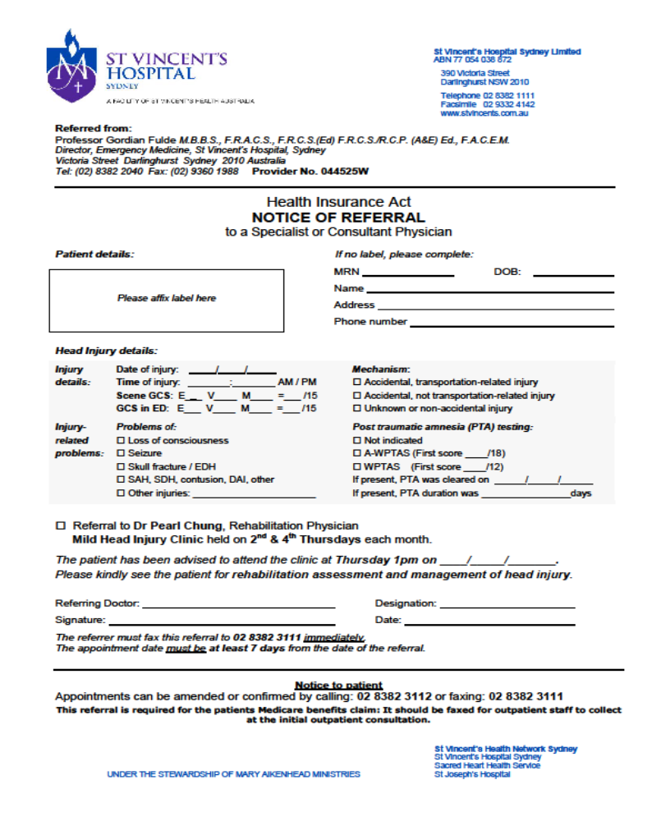
Referral form

Slide 42
Resources for you & your patients in ED …
ACI: Brain Injury Rehabilitation Resources
NSW Insurance Regulatory Body advice sheets: SIRA
Austroads: Fitness to Drive (pdf is free to download add to your ibooks)
I can be contacted thru switch board or Rehab Fellow or CNC

